Slide 1
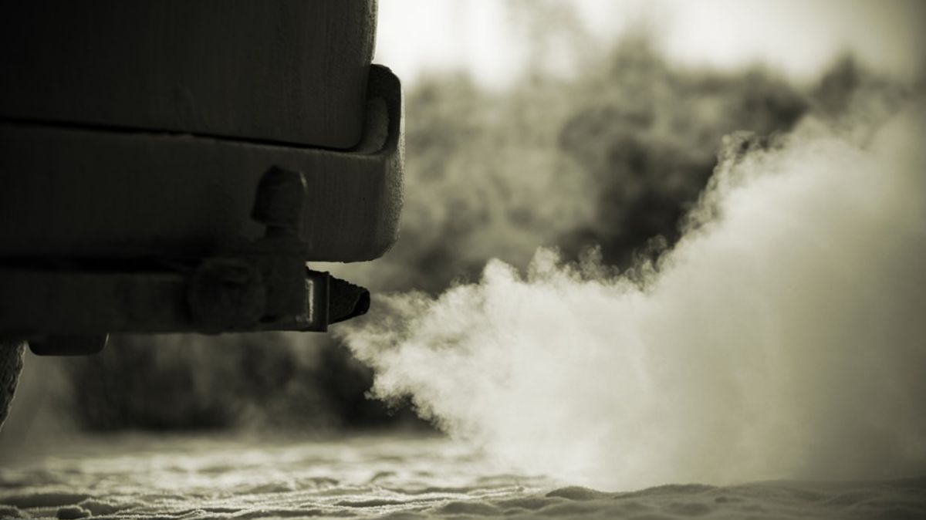
CO₂ Emissions by Motor Vehicles in Canada
Made By: Sidra Kamal

Slide 2

CLIMATE CHANGE MATTERS!!

Slide 3
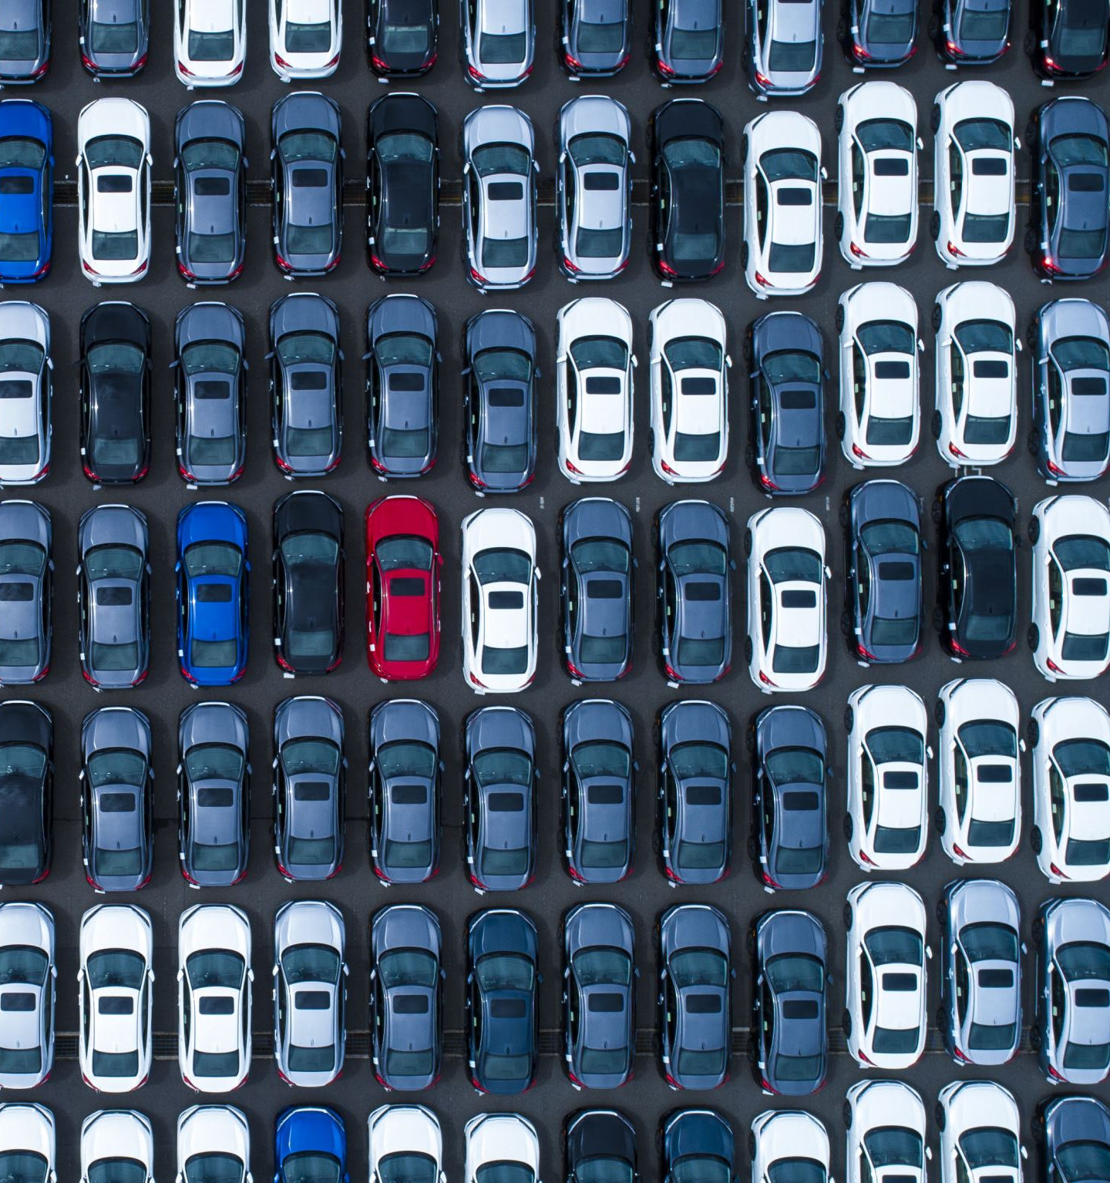
Does Vehicle Type matter for CO₂ Emissions?

Slide 4
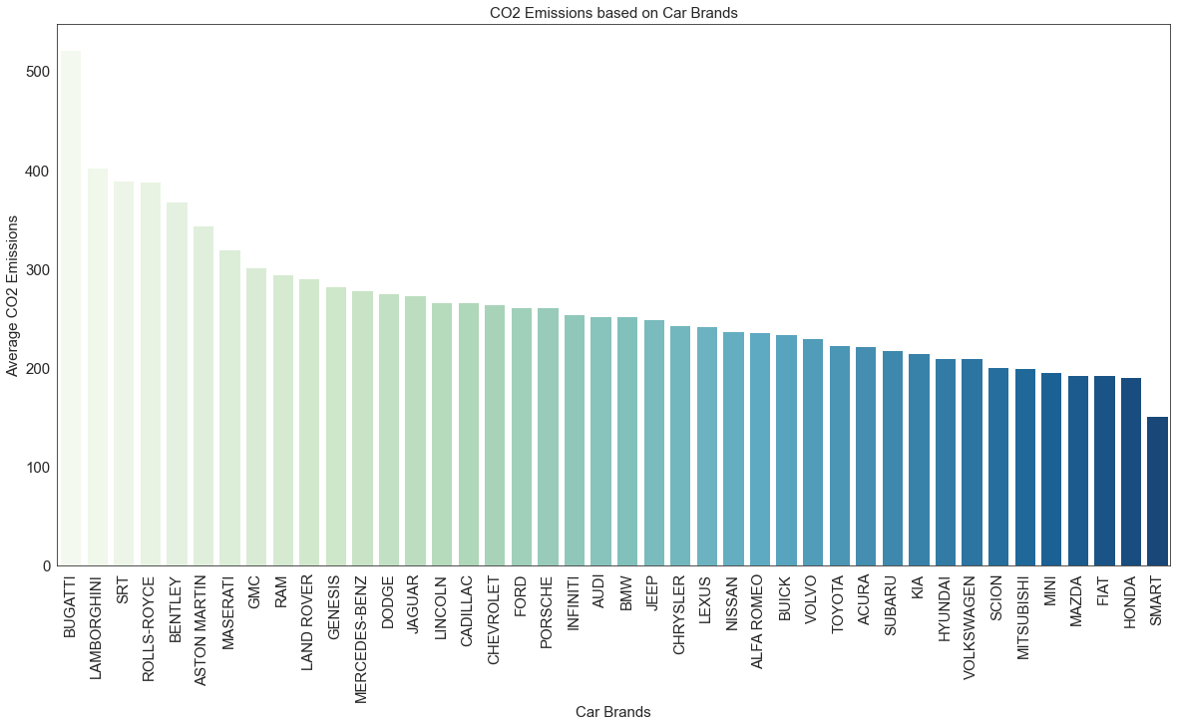

Slide 5
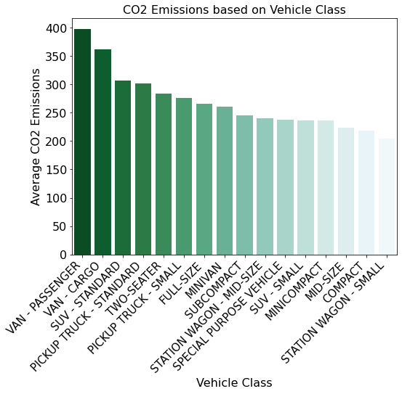
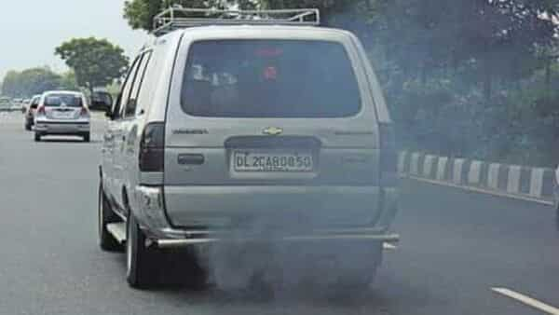

Slide 6
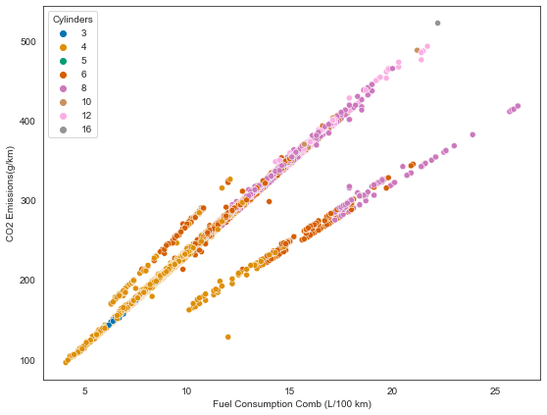

Slide 7
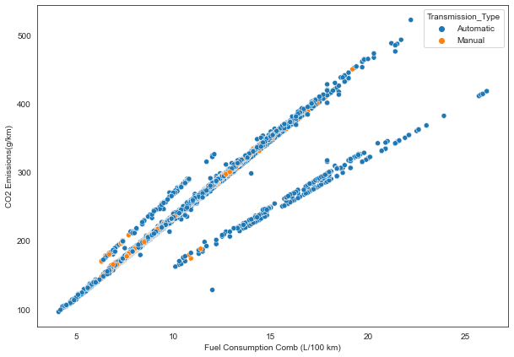

Slide 8
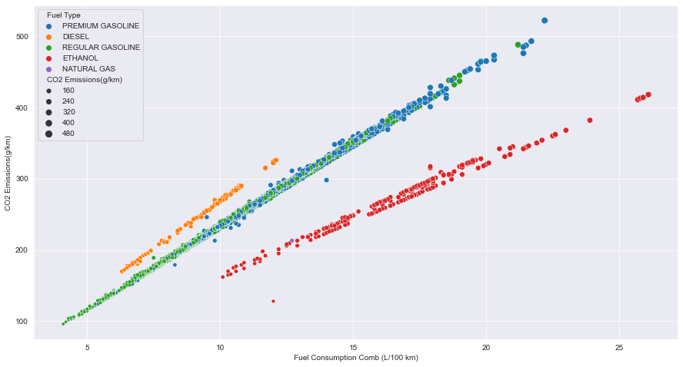

Slide 9

Sports car have the highest emissions because they have powerful engines that burn fuel at a much higher rate than the average daily driver
Vans, SUV and Pickup Trucks have the highest emissions because they are bigger, heavier and the aerodynamics are poor, so as a result there is more CO₂ emissions.
Ethanol is the greenest fuel and has the lowest emission because Ethanol burns more cleanly and completely than gasoline or diesel fuel.
Ethanol reduces greenhouse gas (GHG) emissions because the grain or other biomass used to make the ethanol absorbs carbon dioxide as it grows

Slide 10

Does driving in Highway cause higher emissions than city?

Slide 11
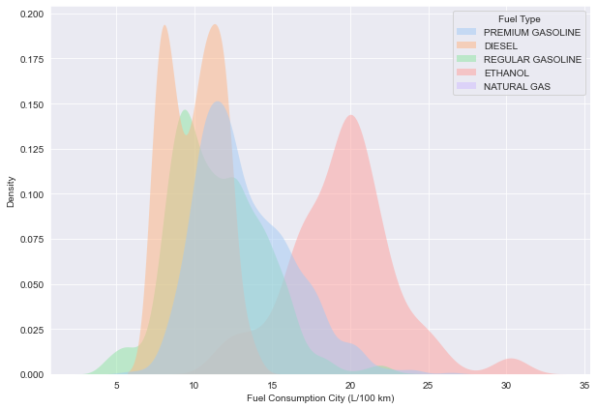

Slide 12
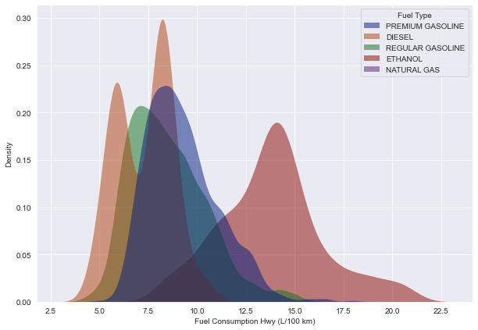

Slide 13

Data Modelling

Slide 14
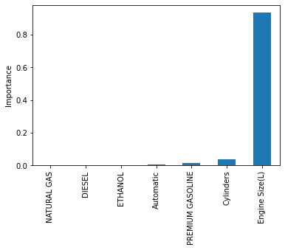
Feature Importance

Slide 15
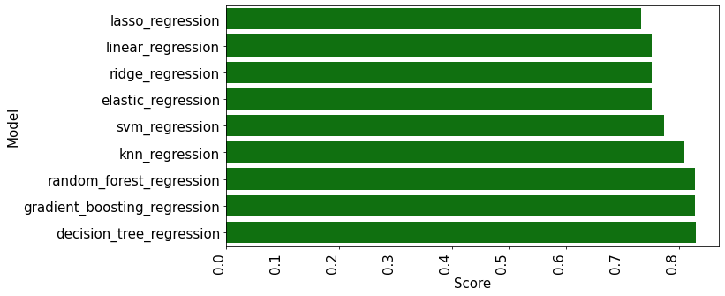
Model Scores

Slide 16

CONCLUSION
Model scores could be improved by incorporating other cars features such as horsepower, weight of the car, types of tires used, A/C and heater features and cruise control.
Government can set regulations by using this model for predicting the emissions from cars in the city and highways.
Decreasing Engine Size(L) and using biofuels can reduce Emissions

